Slide 1
Tensor Analysis

Slide 2
Points:-
What is tensor analysis?
Who invented it?
Brief Study about tensor.
What are the types of tensor?
Difference between tensor and matrix?
Difference between tensor and vector?
What are tensors used for?

Slide 3


What is Tensor Analysis?
Tensor analysis, branch of mathematics concerned with relations or laws that remain valid regardless of the system of coordinates used to specify the quantities. Such relations are called covariant. Tensors were invented as an extension of vectors to formalize the manipulation of geometric entities arising in the study of mathematical manifolds.

Slide 4
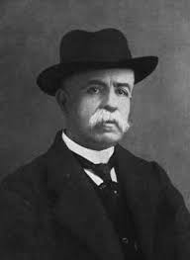
Who invented tensors?
Gregorio Ricci-Curbastro 0. Born on 12 January 1853 in Lugo in what is now Italy, Gregorio Ricci-Curbastro was a mathematician best known as the inventor of tensor calculus.

Slide 5
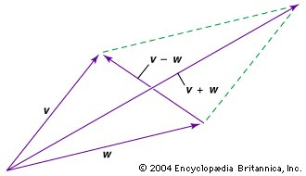
A vector is an entity that has both magnitude and direction; it is representable by a drawing of an arrow, and it combines with similar entities according to the parallelogram law. Because of that law, a vector has components—a different set for each coordinate system. When the coordinate system is changed, the components of the vector change according to a mathematical law of transformation deducible from the parallelogram law. This law of transformation of the components has two important properties. First, after a sequence of changes that end up in the original coordinate system, the components of the vector will be the same as at the start. Second, relationships among vectors—for example, three vectors U, V, W such that 2U + 5V = 4W—will be present in the components regardless of the coordinate system.

Slide 6
A vector therefore may be regarded as an entity that, in n-dimensional space, has n components that transform according to a specific law of transformation having the above properties. The vector itself is an objective entity independent of coordinates, but it is treated in terms of components with all coordinate systems on an equal footing.
Without insisting on a pictorial image, a tensor is defined as an objective entity having components that change according to a transformation law that is a generalization of the vectorial transformation law but that retains the two key properties of that law. For convenience, the coordinates are usually numbered from 1 to n, and each component of a tensor is denoted by a letter having superscripts and subscripts, each of which independently takes on the values 1 to n. Thus, a tensor represented by the components Tabc would have n3 components as the values of a, b, and c run from 1 to n. Scalars and vectors constitute special cases of tensors, the former possessing only one component per coordinate system and the latter possessing n. Any linear relation between tensor components, such as
7Rabcd + 2Sabcd − 3Tabcd = 0,
if valid in one coordinate system, is valid in all and thus represents a relationship that is objective and independent of coordinate systems in spite of the lack of a pictorial representation.

Slide 7
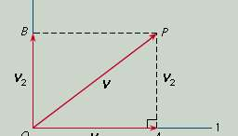
Two tensors, called the metrical tensor and the curvature tensor, are of particular interest. The metrical tensor is used, for example, in converting vector components into magnitudes of vectors. For simplicity, consider the two-dimensional case with simple perpendicular coordinates. Let vector V have the components V1, V2. Then by the Pythagorean theorem applied to the right triangle OAP the square of the magnitude of V is given by
OP2 = (V1)2 + (V2)2.

Slide 8
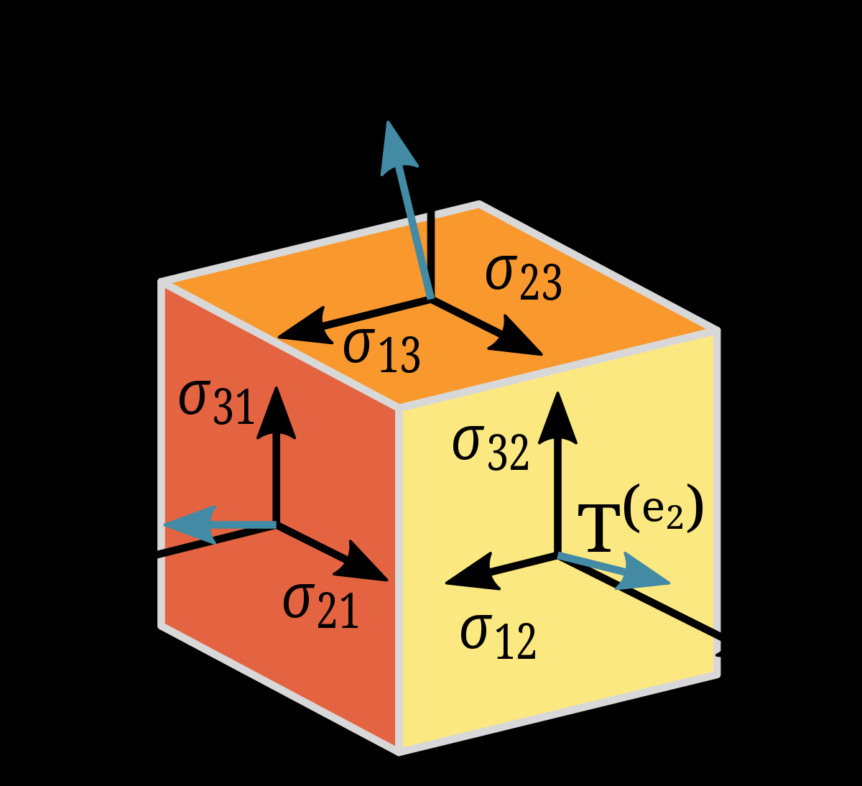
Hidden in this equation is the metrical tensor. It is hidden because it here consists of 0’s and 1’s that are not written in. If the equation is rewritten in the form
OP2 = 1(V1)2 + 0V1V2 + 0V2V1 + 1(V2)2,
the full set of components (1, 0, 0, 1) of the metrical tensor is apparent. If oblique coordinates are used, the formula for OP2 takes the more general form
OP2 = g11(V1)2 + g12V1V2 + g21V2V1 + g22(V2)2,
the quantities g11, g12, g21, g22 being the new components of the metrical tensor.

Slide 9
Out of the metrical tensor it is possible to construct a complicated tensor, called the curvature tensor, that represents the various aspects of the intrinsic curvature of the n-dimensional space to which it belongs.
Tensors have many applications in geometry and physics. In creating his general theory of relativity, Albert Einstein argued that the laws of physics must be the same no matter what coordinate system is used. This led him to express those laws in terms of tensor equations. It was already known from his special theory of relativity that time and space are so closely interrelated as to constitute an indivisible four-dimensional space-time. Einstein postulated that gravitation should be represented solely in terms of the metrical tensor of four-dimensional space-time. To express the relativistic law of gravitation, he had as building blocks the metrical tensor and the curvature tensor formed from it. Once he decided to confine himself to these building blocks, their very paucity led him to an essentially unique tensor equation for the law of gravitation, in which gravitation emerged not as a force but as a manifestation of the curvature of space-time.
While tensors had been studied earlier, it was the success of Einstein’s general theory of relativity that gave rise to the current widespread interest of mathematicians and physicists in tensors and their applications.

Slide 10

What is the rank of tensor?
The rank of a tensor T is the minimum number of simple tensors that sum to T (Bourbaki 1989, II, §7, no. 8). The zero tensor has rank zero. A nonzero order 0 or 1 tensor always has rank 1
The total number of contravariant and covariant indices of a tensor. The rank of a tensor is independent of the number of dimensions. of the underlying space.

Slide 11

What are tensors used for?
Tensors are a type of data structure used in linear algebra, and like vectors and matrices, you can calculate arithmetic operations with tensors

Slide 12
What is difference between matrix and tensor?
What is difference between matrix and tensor?
The basic idea, though, is that a matrix is just a 2-D grid of numbers. A tensor is often thought of as a generalized matrix. ... Any rank-2 tensor can be represented as a matrix, but not every matrix is really a rank-2 tensor.

Slide 13
What is difference between tensor and vector?
What is difference between tensor and vector?
Any quantity that has both magnitude and direction is called a vector. ... The only difference is that tensor is the generalized form of scalars and vectors . Means scalars and vectors are the special cases of tensor quantities. Scalar is a tensor of rank 0 and vector is a tensor of rank 1.

Slide 14
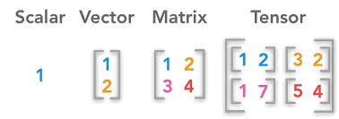


Slide 15
Thank you

